Slide 1

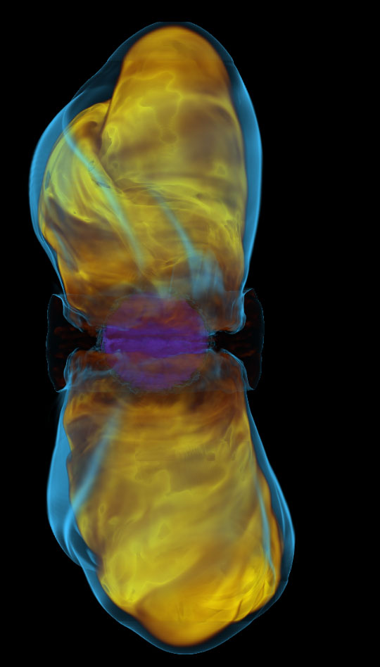
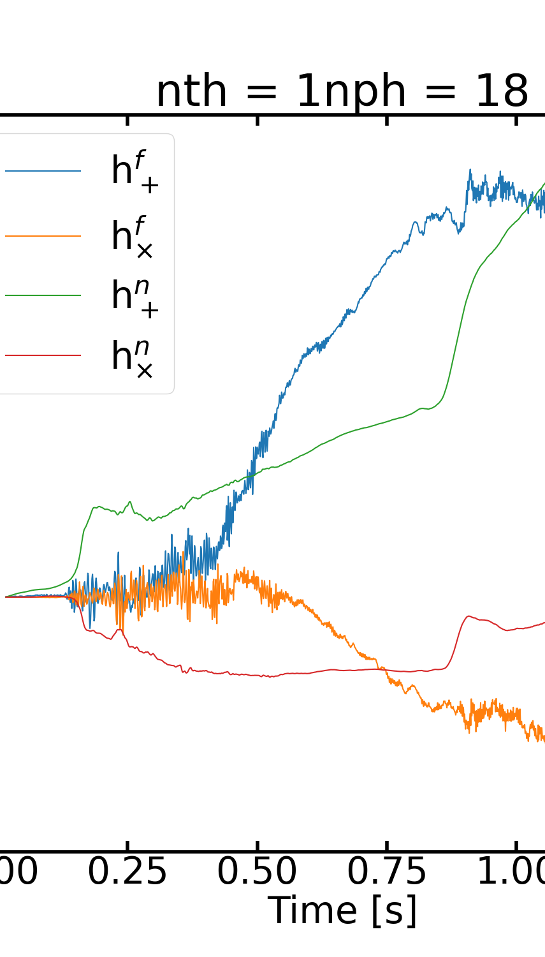

Taperings and Analytic Continuations of Supernova GWs with Memory
Colter Richardson, Michele Zanolin, Haakon Andresen, Marek Szczepanczyk, Kiranjyot Gill, and Annop Wongwwathanarat
[1]

Slide 2
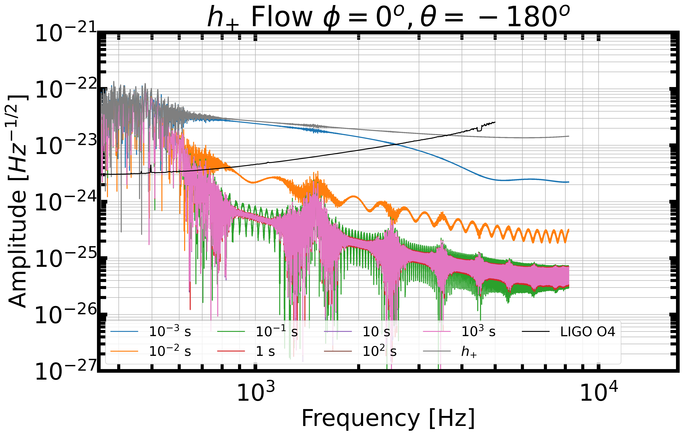
An Invitation: Tapering is Necessary
A GW with memory should not be injected into data as they are, because the discontinuities induce high frequency artifacts in the signal.
Marek Szczepanczyk’s SN Toolkit, already has a tool to add a tapering.
Marek Szczepanczyk / SNGW · GitLab (ligo.org)

Slide 3
Memory Properties
Linear Vs. Non-Linear Memory Production
Low Frequency Emission
The W15-2 simulation (test example)
The angular dependence of the example model’s memory and three toy models.
Tapering
A proposed analytic extension function for GW signals from neutrino emission.
SNR results for the tapered signals for both ground-based and space-based detectors.
Notes:
However, given the issue we noticed, we decided to do a systematic study on the properties of the memory in a GW signal, and how to use these signals in GW data analysis.

Slide 4

Linear vs. Non-Linear Memory
Non-linear memory is the effect GWs have on the production of other GWs. This is primarily seen in binary mergers.
This effect represents a correction to the quadrupole approximation on the order of $ϑ{\left(\frac{Gm}{r}c^{2}\right)}^{5/2}$ (m is the total mass of the source, r is the spatial size of the source, c is the speed of light, and G is Newtons constant). This corresponds to a correction at the 2.5th order in the post-Newtonian expansion, which is only relevant for the most relativistic systems [2].
This study only focuses on the linear memory of GW simulations from CCSN.
The memory will peak $\sim 1$ Hz, but the tail can survive at lower frequencies.
The two next mechanisms to appear in the signal (for increasing frequency) are the SASI and the PNS oscillations.

Slide 5
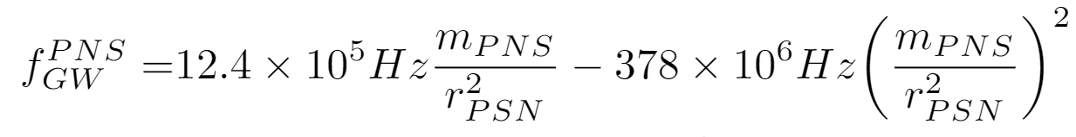
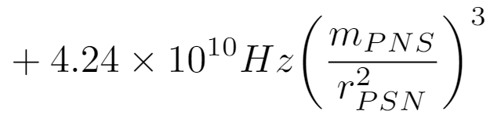
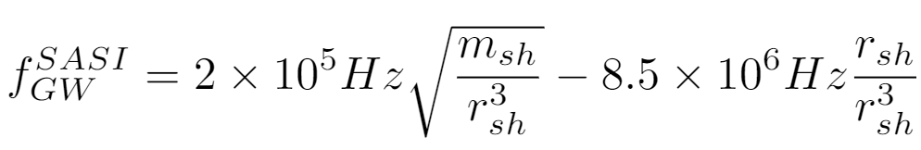

Low Frequency Emission
Specifically, we calculate the frequency of these features by the following,
Here $m_{PNS}=M_{PNS}/M_{⊙}$, $r_{PNS}=R_{PNS}/1km$, $m_{sh}=M_{sh}/M_{⊙}$, and $r_{sh}=R_{sh}/1km$.
[3]
G-mode frequency grows over time.
5

Slide 6

Low Frequency Emission
If for example the PNS has a mass of 1.4 solar masses, the PNS has a radius of 60 km, and the shock radius is 150 km,
$f_{GW}^{PNS}≈430 Hz$ and $f_{GW}^{SASI}≈125 Hz$
These low frequencies are below the frequency range of both the SASI (50 Hz – 200 Hz) and the oscillations of the PNS (> 300 Hz).
6

Slide 7

W15-2 Simulation Parameters [4]
We focus on the 3-D simulation (specifically W15-2) performed by A. Wongwathanarat.
Simulated from 15 ms after bounce until the shock breaks out of the stellar surface.
Carried out in two phases
The first phase lasts until 1.3 s after core bounce, during this phase the shock is successfully revived.
In the second, the data from the first phase was mapped onto a new grid which made it possible to follow the shock as it propagated through the stellar progenitor. Due to computational limitations, the second phase did not include neutrino transport (unlike phase 1).
Non-Rotating
${15 M}_{⨀}$

Slide 8
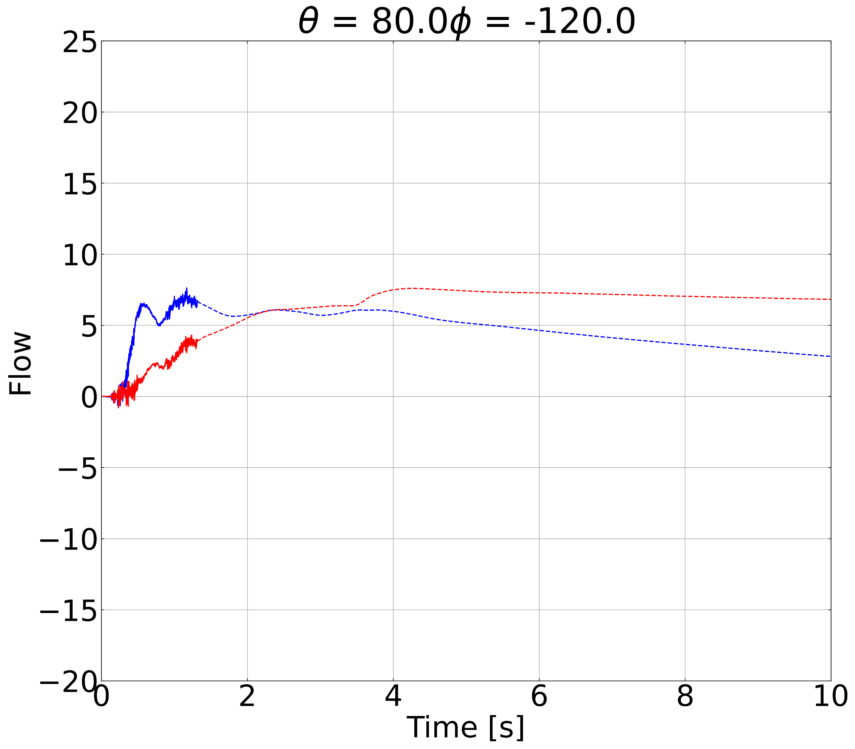
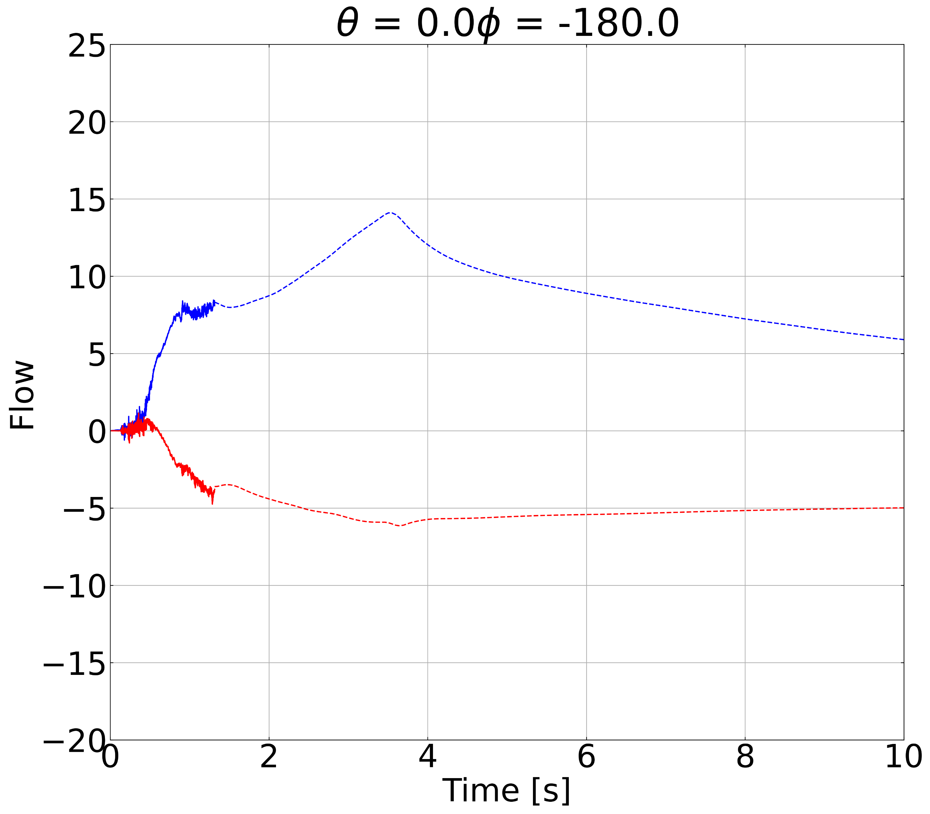
W15-2 Example Waveforms
Below are two example waveforms from the W15-2 simulation for only the GW from the flow.
In both cases, the final value of GW strain (both in phase 1 and phase 2) is not zero, indicating a memory.
Phase 1 is represented by the solid lines and phase 2 is represented by the dashed lines.

Slide 9
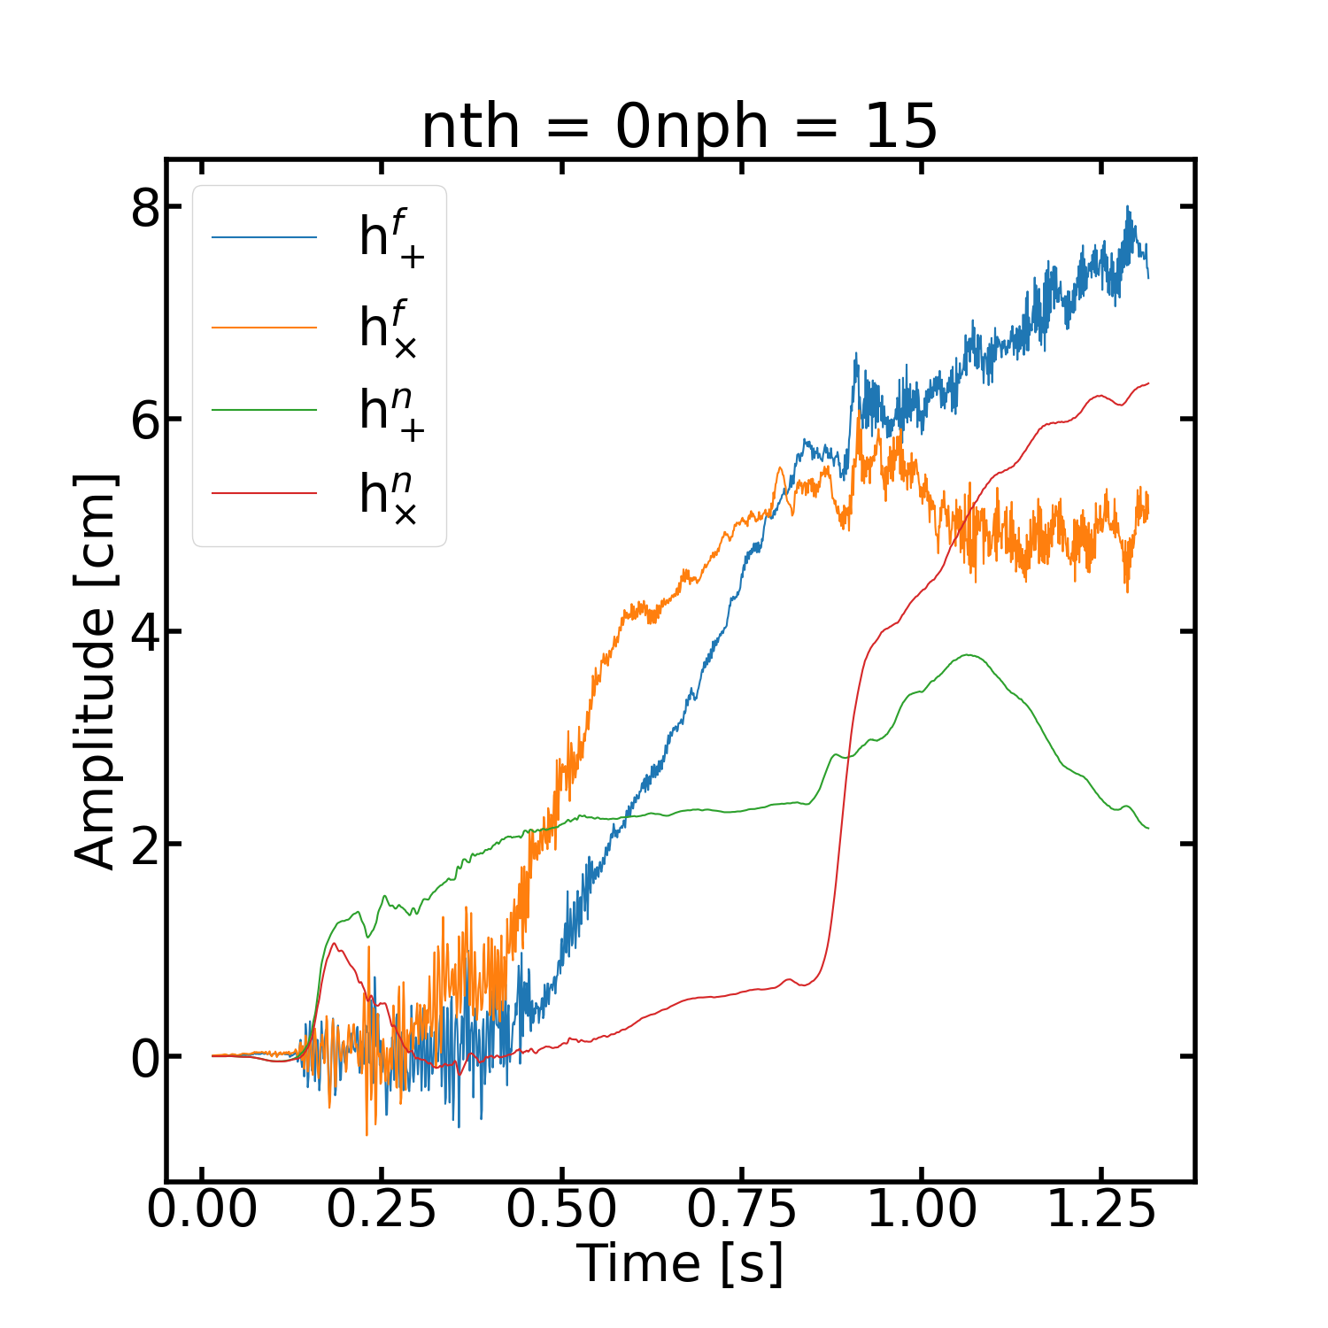
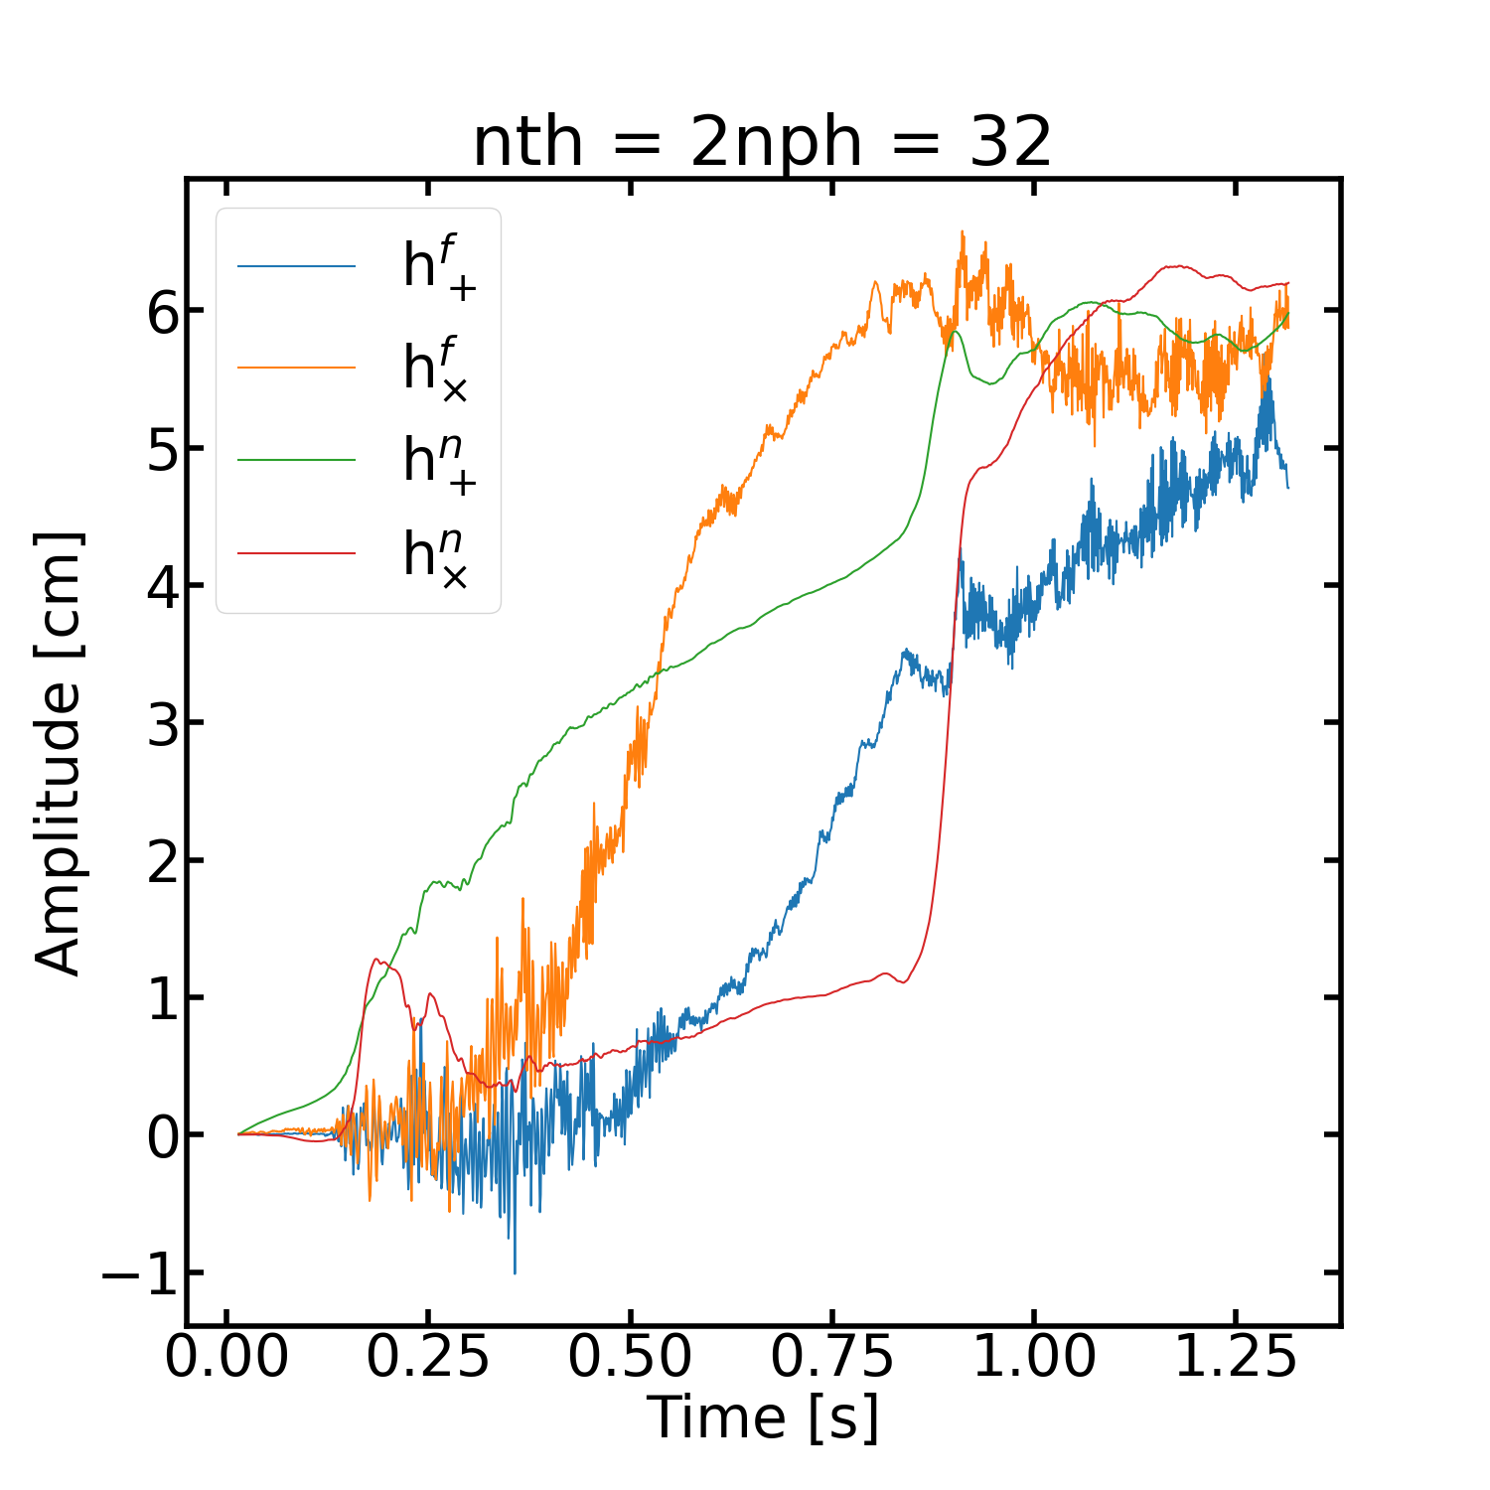
W15-2 Example Waveforms
Below are two example waveforms from the W15-2 simulation for only the GW from the flow and neutrinos.
In both cases, the final value of GW strain (both in phase 1 and phase 2) is not zero, indicating a memory.

Slide 10
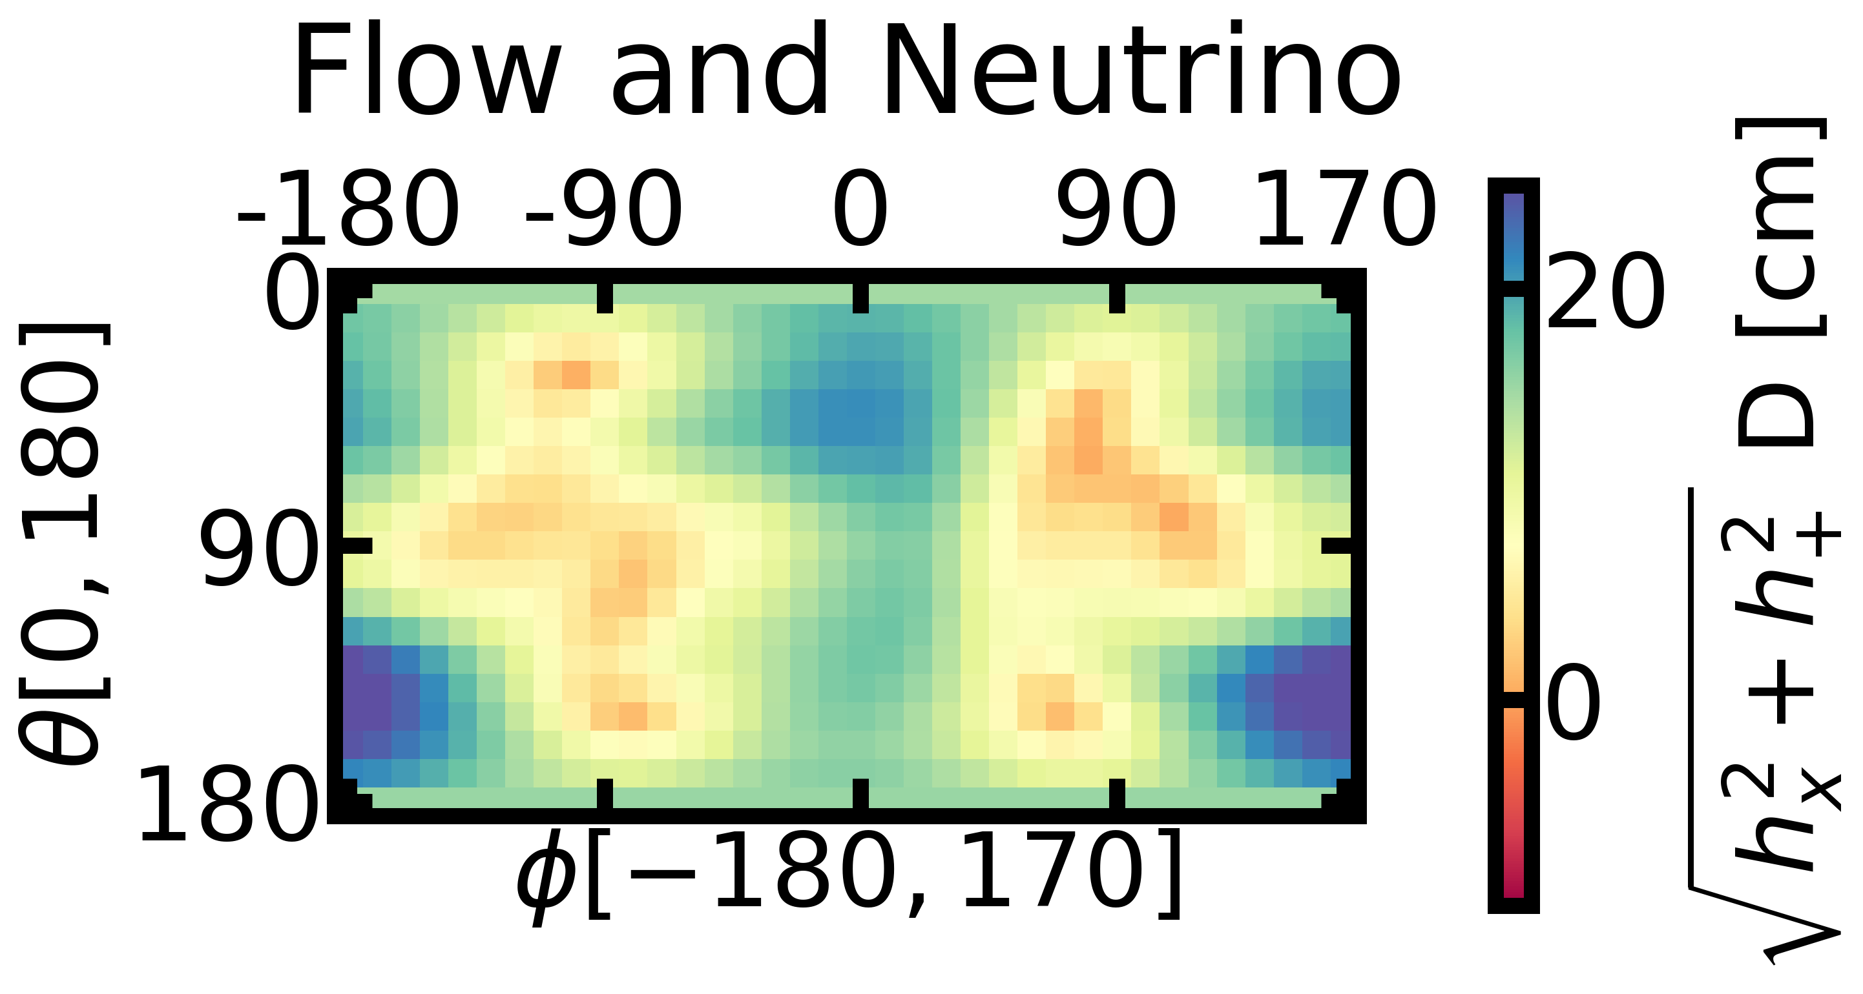
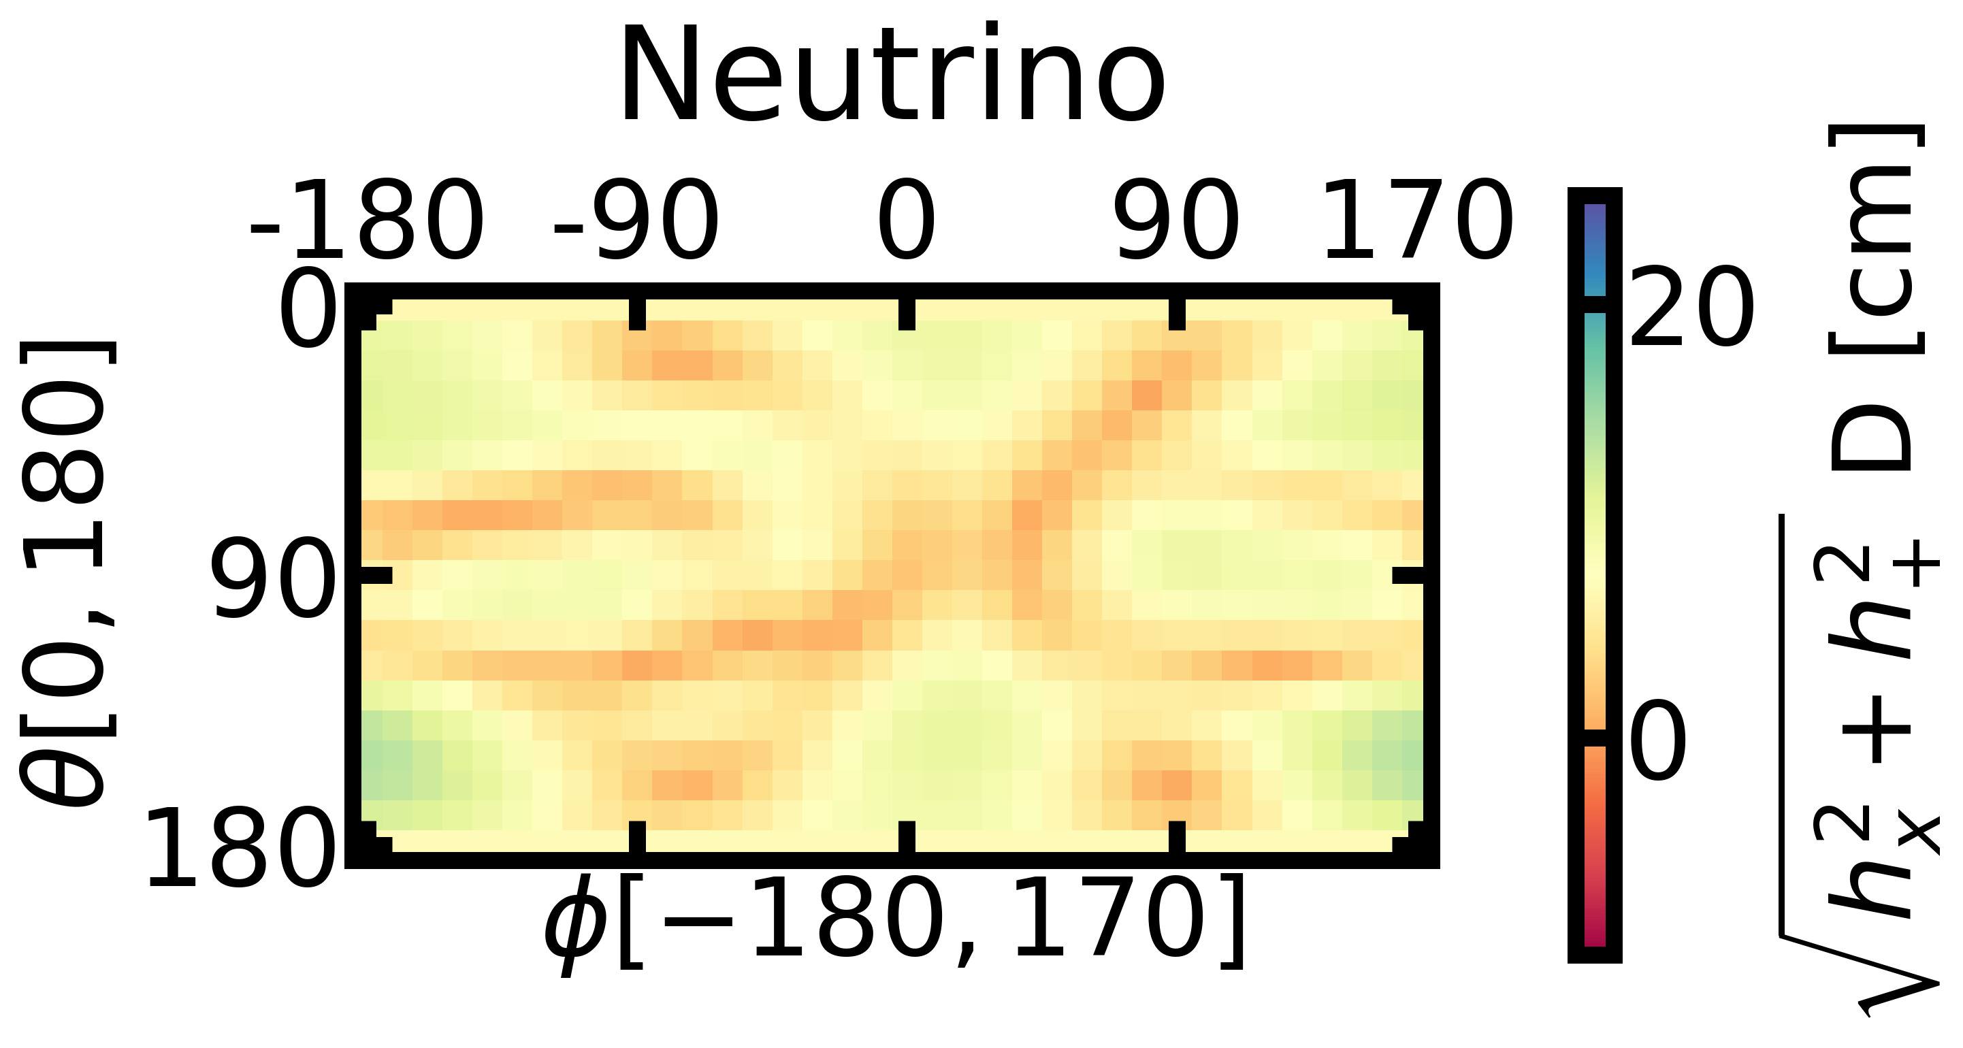
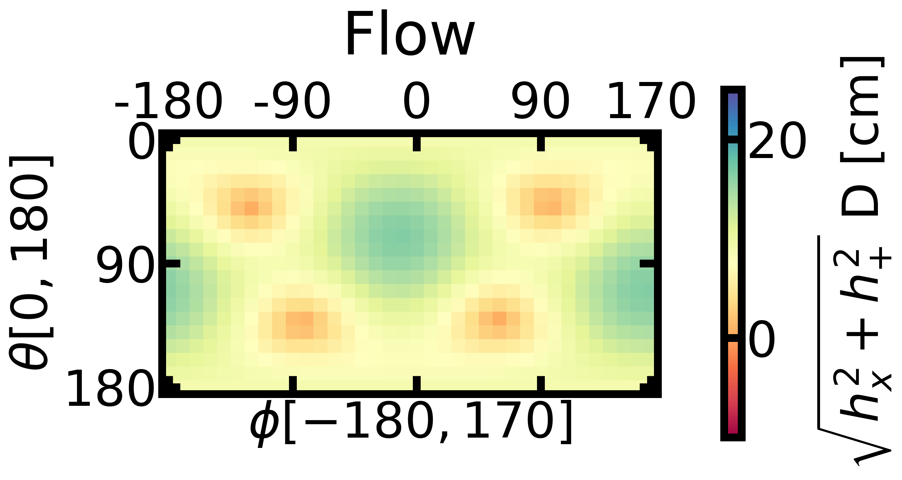

Angular Dependence
We initially investigate the memory when phase 1 ends, due to the loss of GWs from the neutrino emission.
The gauge independent $\sqrt{h_{+}^{2}+h_{×}^{2}}$ is of interest due to its independence of observer orientation.
We primarily analyze the total GW signal (from matter and neutrinos), but also investigate the independent components.
The GW memory from the flow is more regular than that of the neutrinos.
These plots also detail the amount of angular separation needed to detect a difference in the signals.

Slide 11
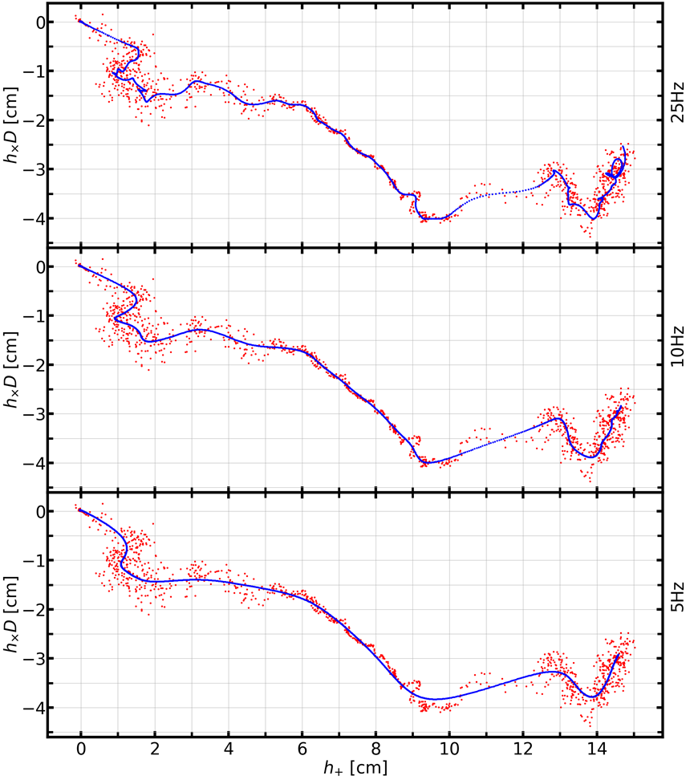
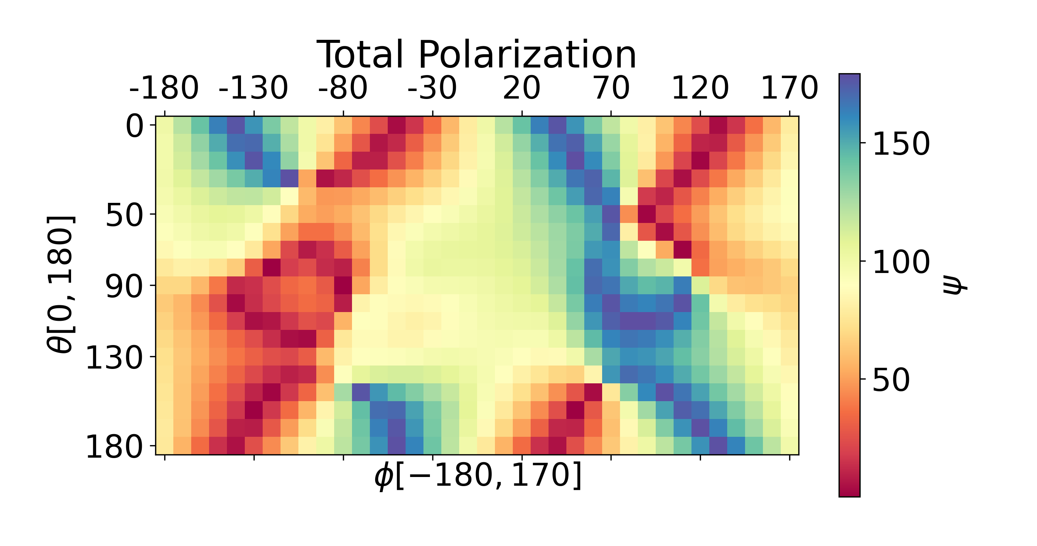
Linearity in the Low Frequency Limit
As the high frequency components are removed, the signal becomes linearly polarized.
Which for the memory specifically we find the rotation angle ψ that diagonalizes the GW matrix for every direction at 1.3 seconds.
Notes:
At any given time the metric is symmetric, as such you can always diagonalize it. However, if you have a signal with high frequency, the angle psi that diagonalizes the metric changes over time., What we call a linearly polarized signal is one that psi does not change over time. In the case of the low frequency, the DC limit does not change over time, so the angel does not change over time either.

Slide 12
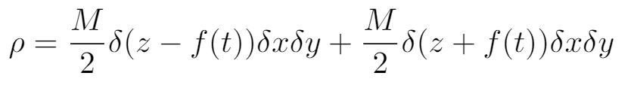
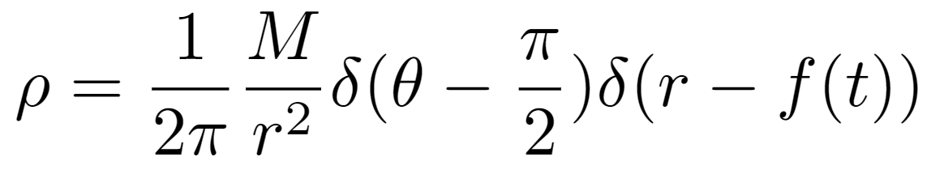
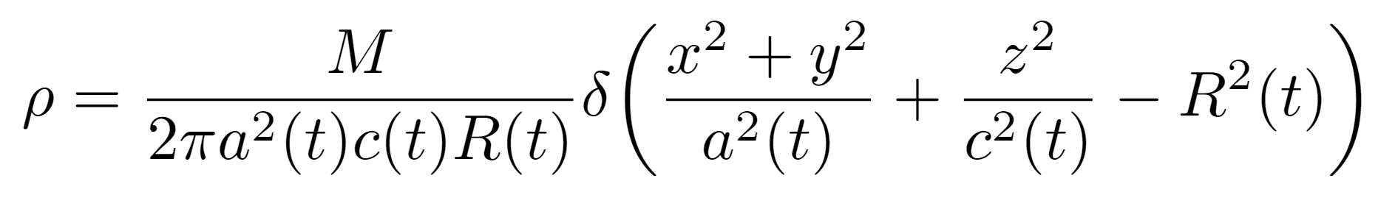

Toy Models
We investigate how three axis symmetric toy models of the explosion mimic the angular dependence of the numerical simulation.
Prolate: Where the mass is ejected in two beams along the explosion axis.
Oblate: Where the mass is ejected in a disk in the plane perpendicular to the explosion axis.
Spheroid: Where the mass is ejected in a shell defined by two parameters $a\left(t\right)$ and $c(t)$ detailing the stretching perpendicular to the explosion axis and perpendicular to the explosion axis respectively.
12

Slide 13
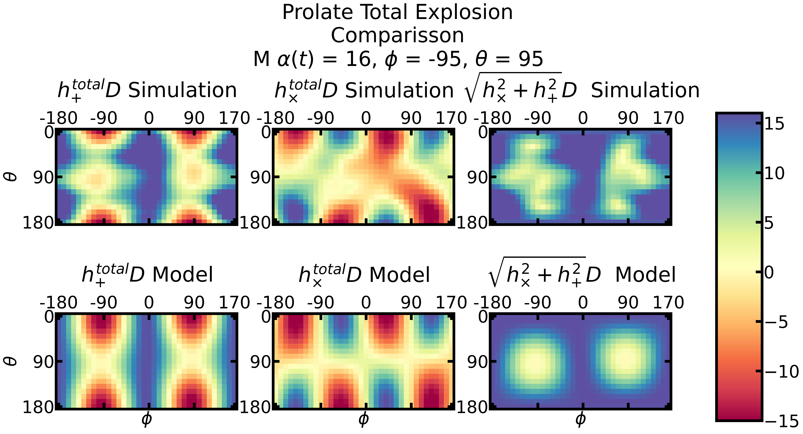

Slide 14
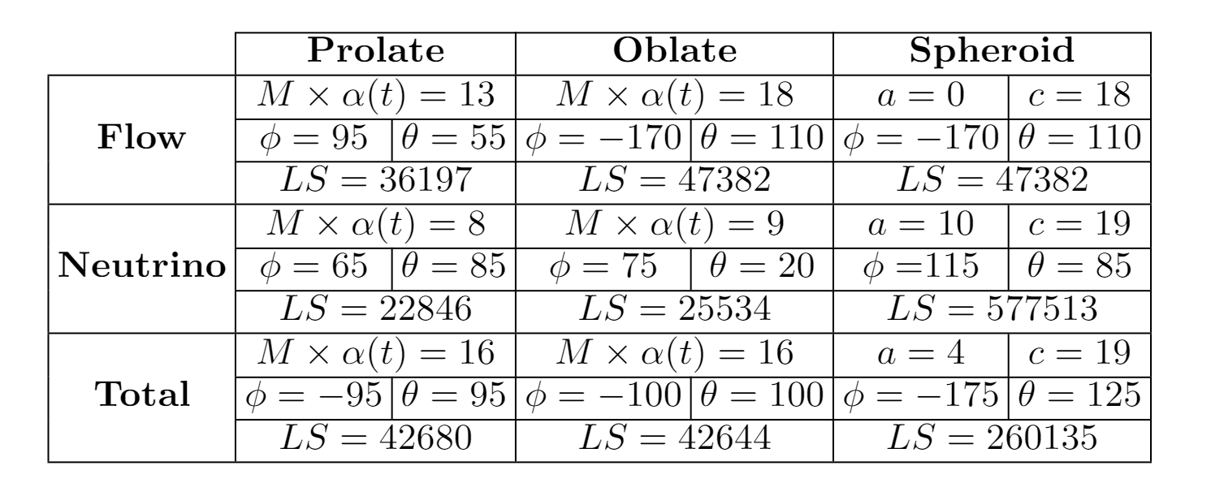
Least Square
We compare the toy model to the simulation for the gauge independent values and find the minimzed least square values for the explosion angle.
The most comparable toy model is that of the prolate explosion.
If we could determine the explosion angle and the Mα term from an electromagnetic observation, then this least square analysis could be used for multimessenger interpretations of the event.

Slide 15
Taperings
Simulations are often cut off due to computational expense, so we propose an extension to allow the signal to come to a saturation value and then return to zero to mimic the detector.
The effect of the tapering greatly alters the signal at the injected frequencies, but by choosing specific taperings for different detectors will increase the SNR and keep the relevant portions of the signal unaffected.

Slide 16
Taperings
By adding a tapering, the signal is altered by decreasing amplitudes at high frequencies and increases amplitudes at low frequencies.
The next plot show the tails applied in the time domain to an example signal.
The second plot shows the fft of a tapered signal at 1 kpc for different tails.
The future detectors are also shown as a comparison of their noise floors and the signal.

Slide 17
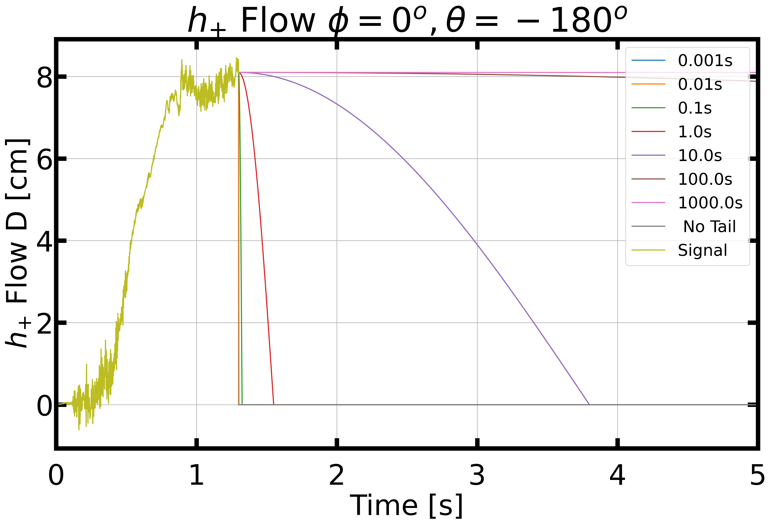

Slide 18
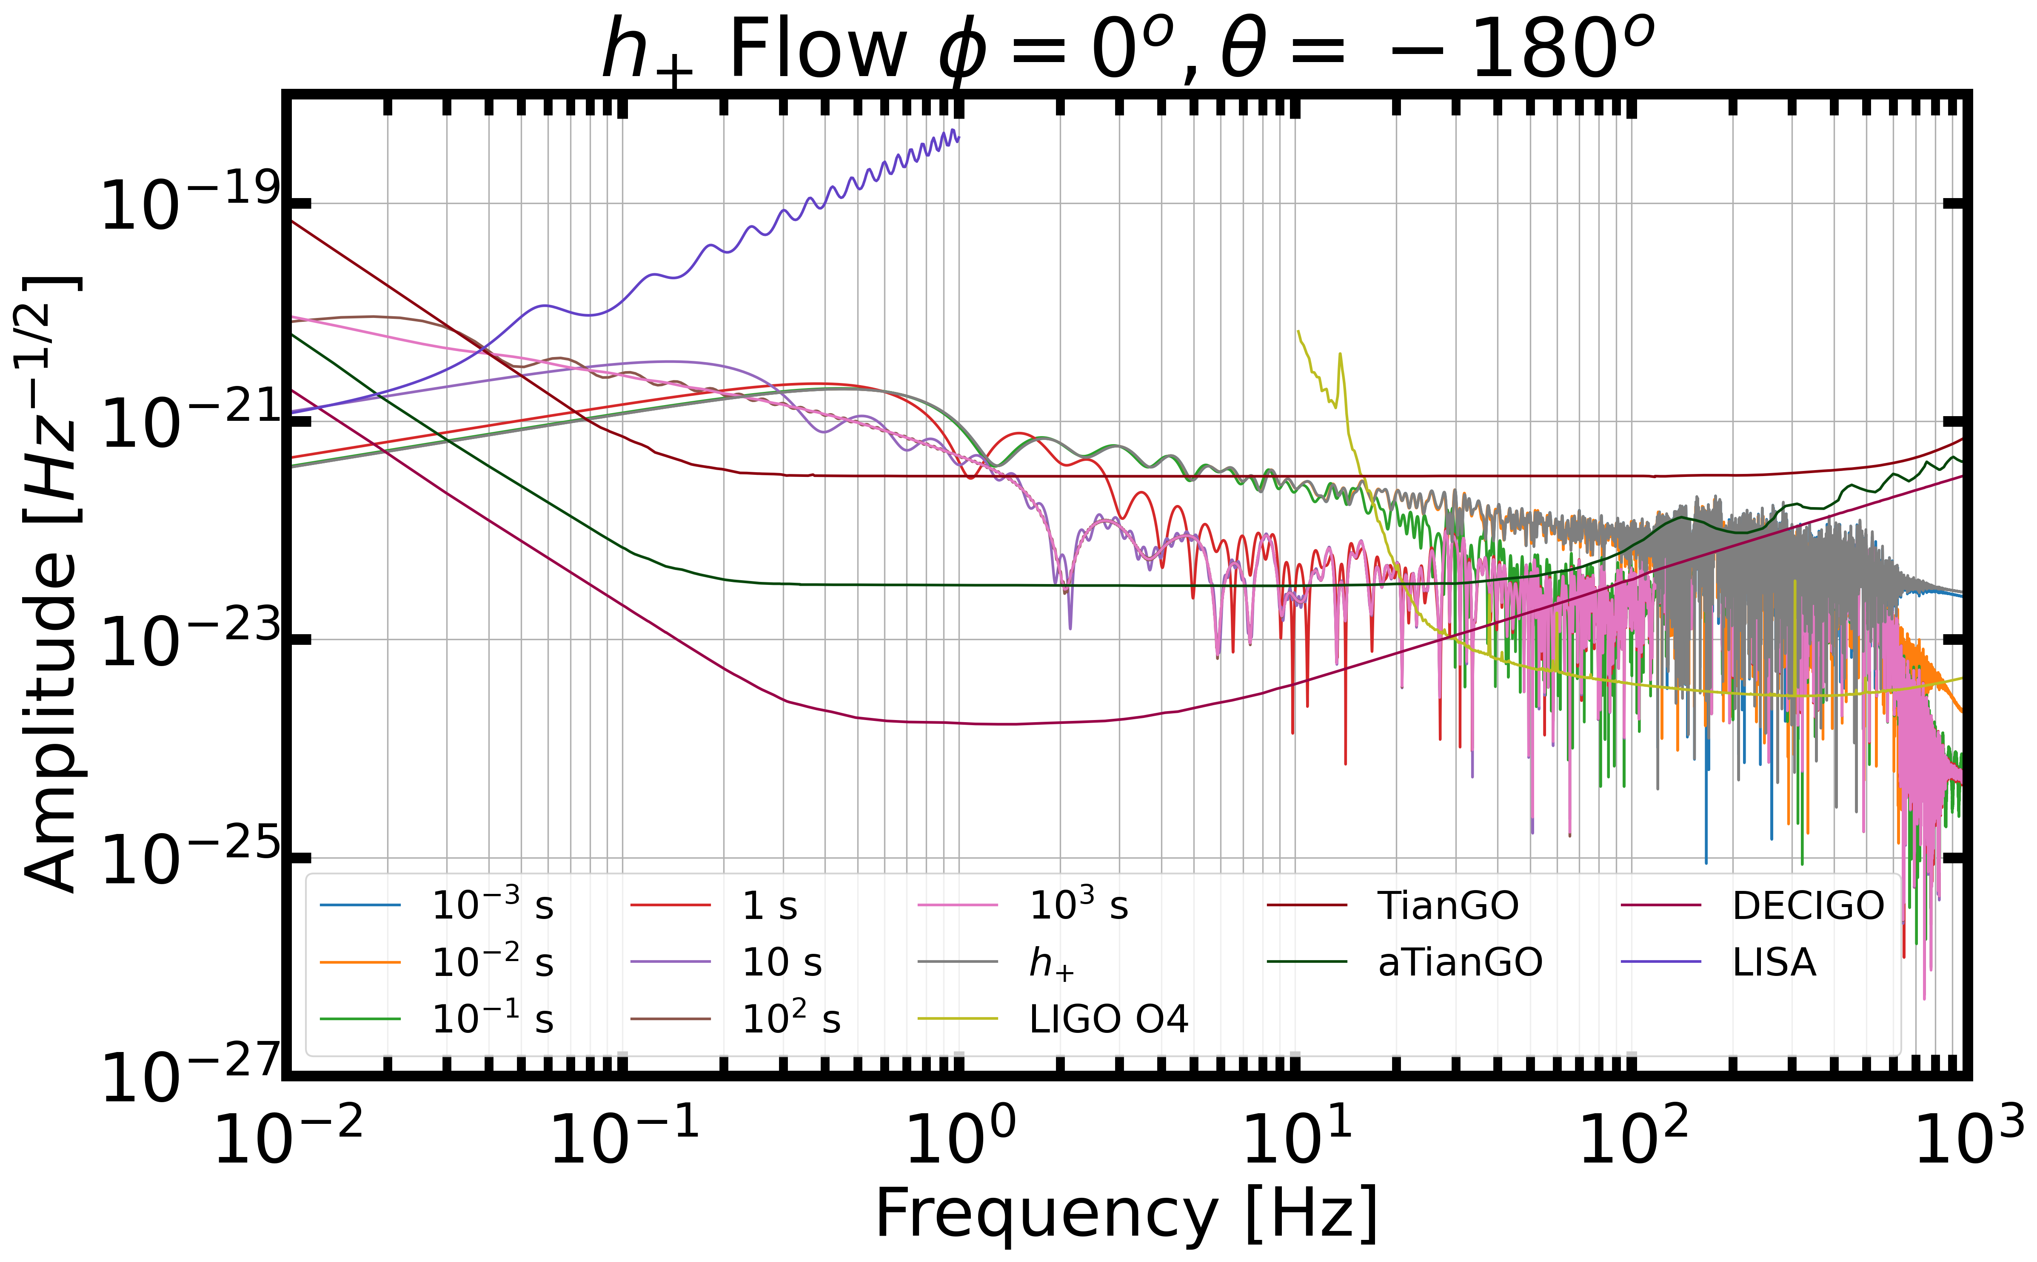

Slide 19
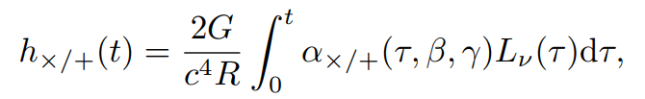

Extension
Due to the termination of the neutrino transport in the second phase, no GWs are produced by the neutrinos.
Due to the non-zero GW value at 1.3s, we propose an extension model to approximate the GWs from the neutrinos in the later times.
The GWs associated with the anisotropic neutrino emission [5]
Were $L_{ν}$ is the neutrino luminosity, and α is the anisotropy parameter.

Slide 20


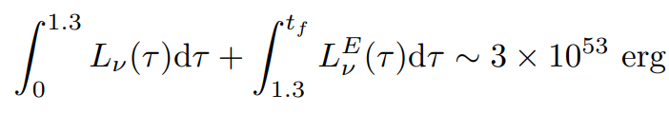
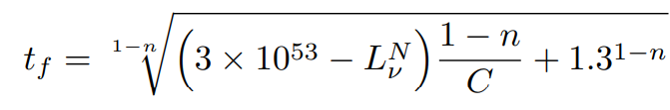

Extension
During the cooling phase of the PNS, the luminosity can be approximated by
From this we can approximate the constant C based on the final value of the neutrino luminosity
For the W15-2 simulation the energy radiated by neutrinos is $\sim 3×{10}^{53}$erg, and so
The end time of the neutrino burst can be found as

Slide 21
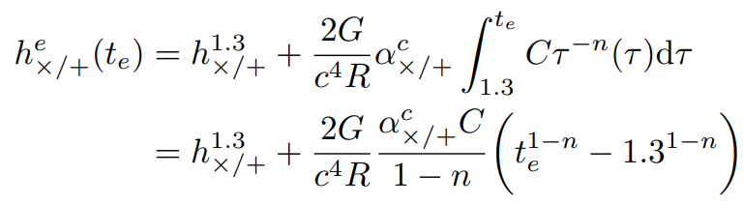
Extension
Assuming the anisotropy parameter remains constant, we can approximate the GW signal from neutrinos, after the neutrino transport is turned off, to be
This is independent of the simulation, and is a computationally less exhaustive, so this can be used with any simulation to extend the GW signal.

Slide 22
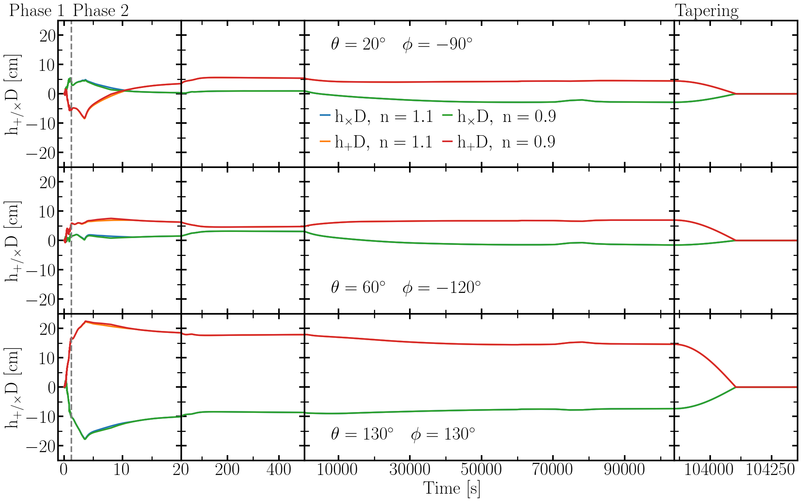

The plot to the left details the extended (Phase 2 to fourth axis) and tapered (final axis) signal.
The choice of $n=1.1$ and $n=0.9$ shows that for values of $n\sim 1$, the extension does not vary much.

Slide 23
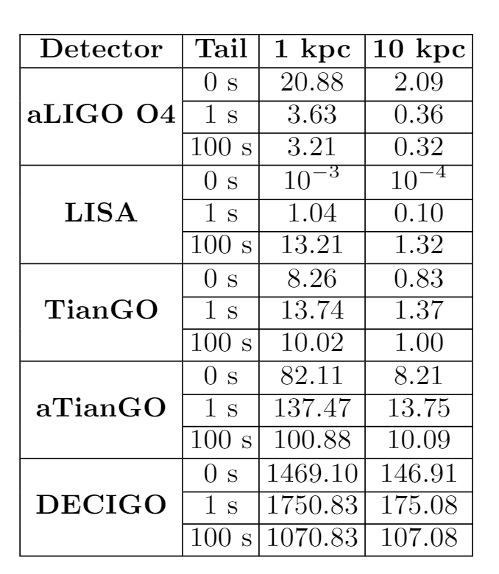
SNR
By altering the signal with a tail, the Signal-to-Noise Ratio will also be changed.
The table, right, shows the SNR of the unaltered signal (Tail = 0s) and the SNR of altered signal (Tail = 1s and 100s) at both 1 kpc and 10 kpc.
The SNRs calculated are between 0 Hz and 50 Hz.

Slide 24
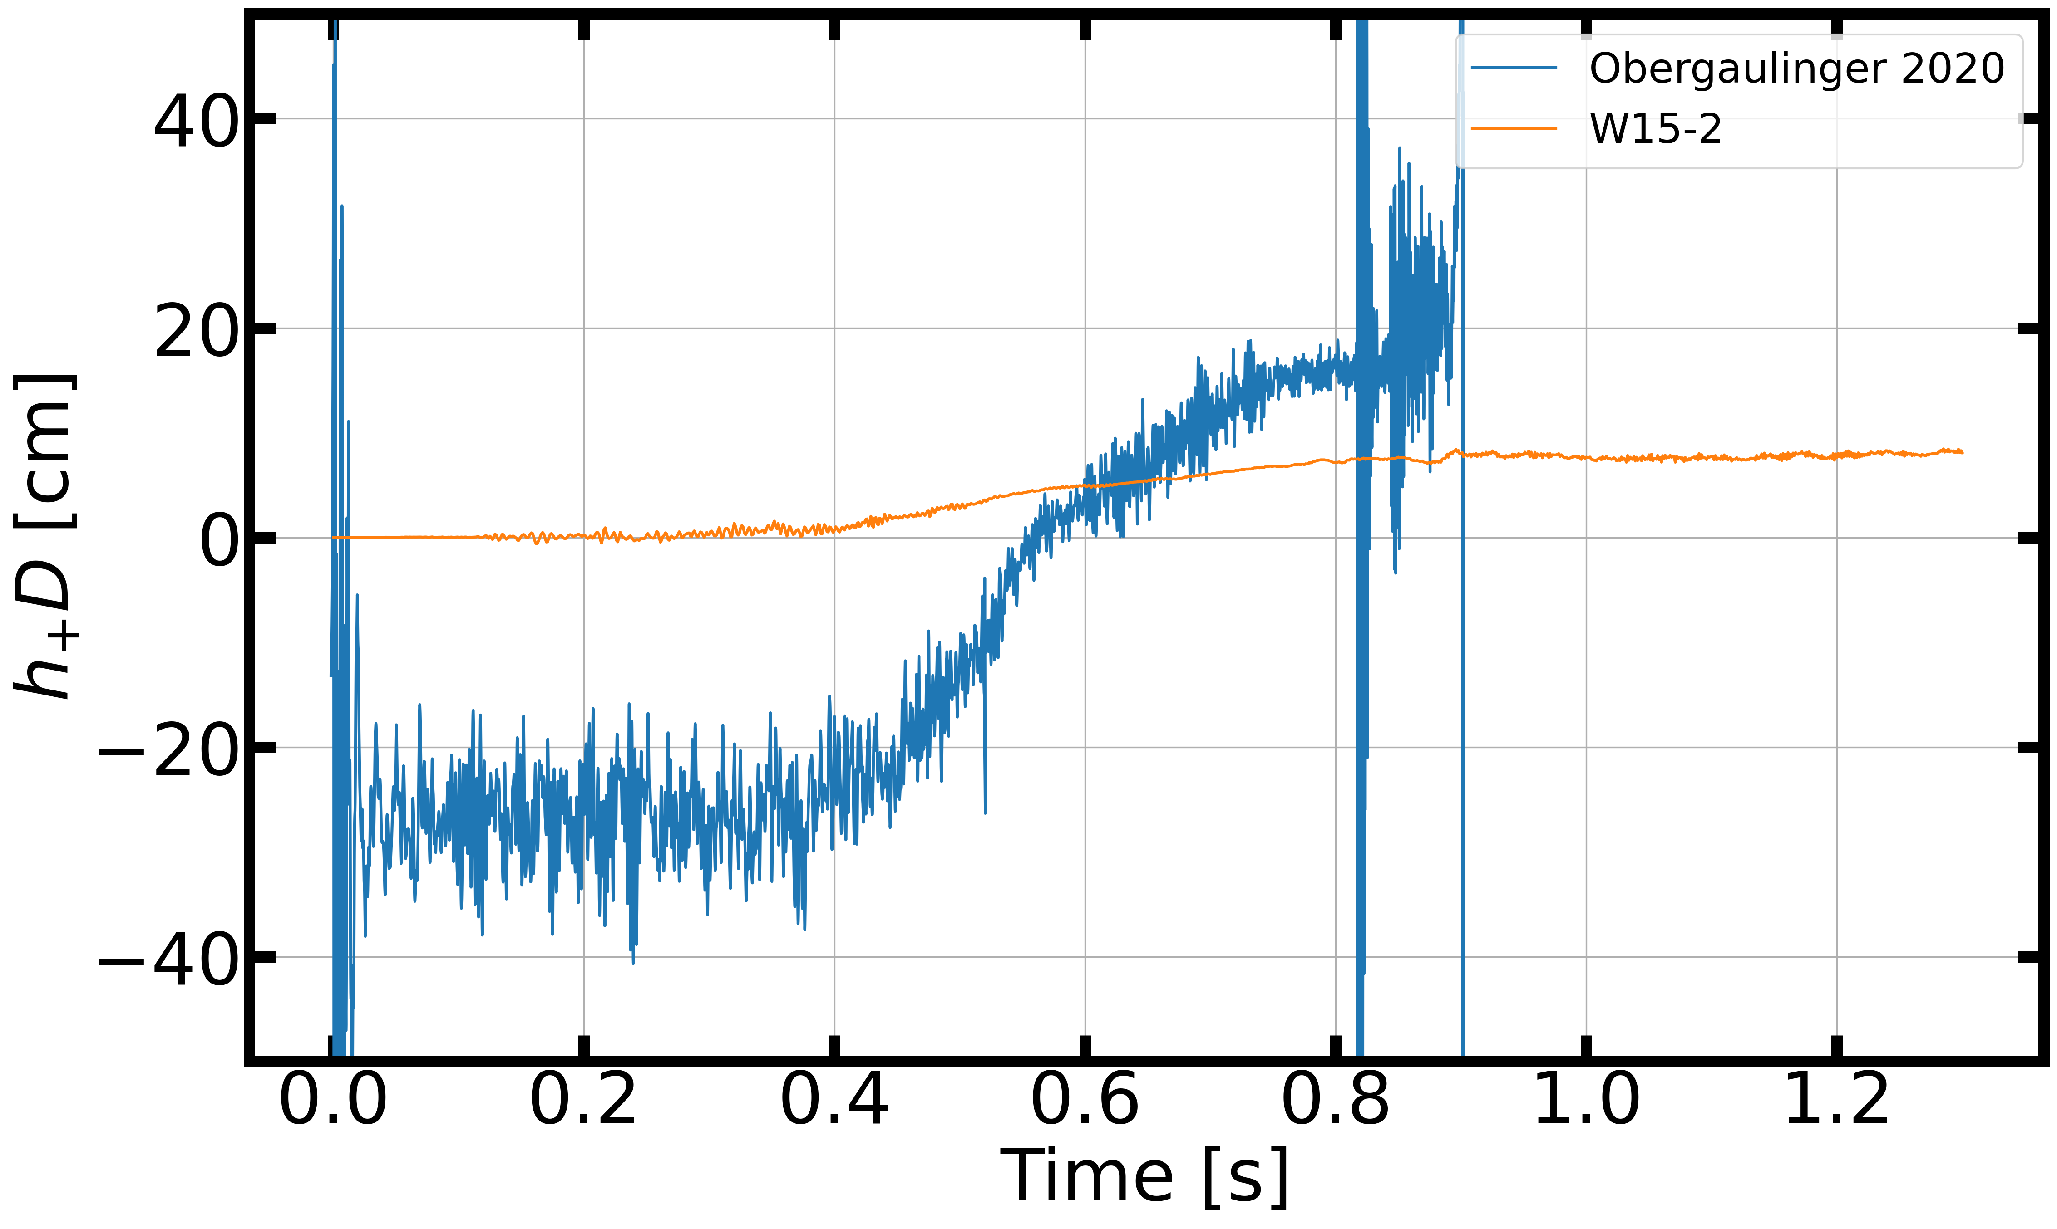
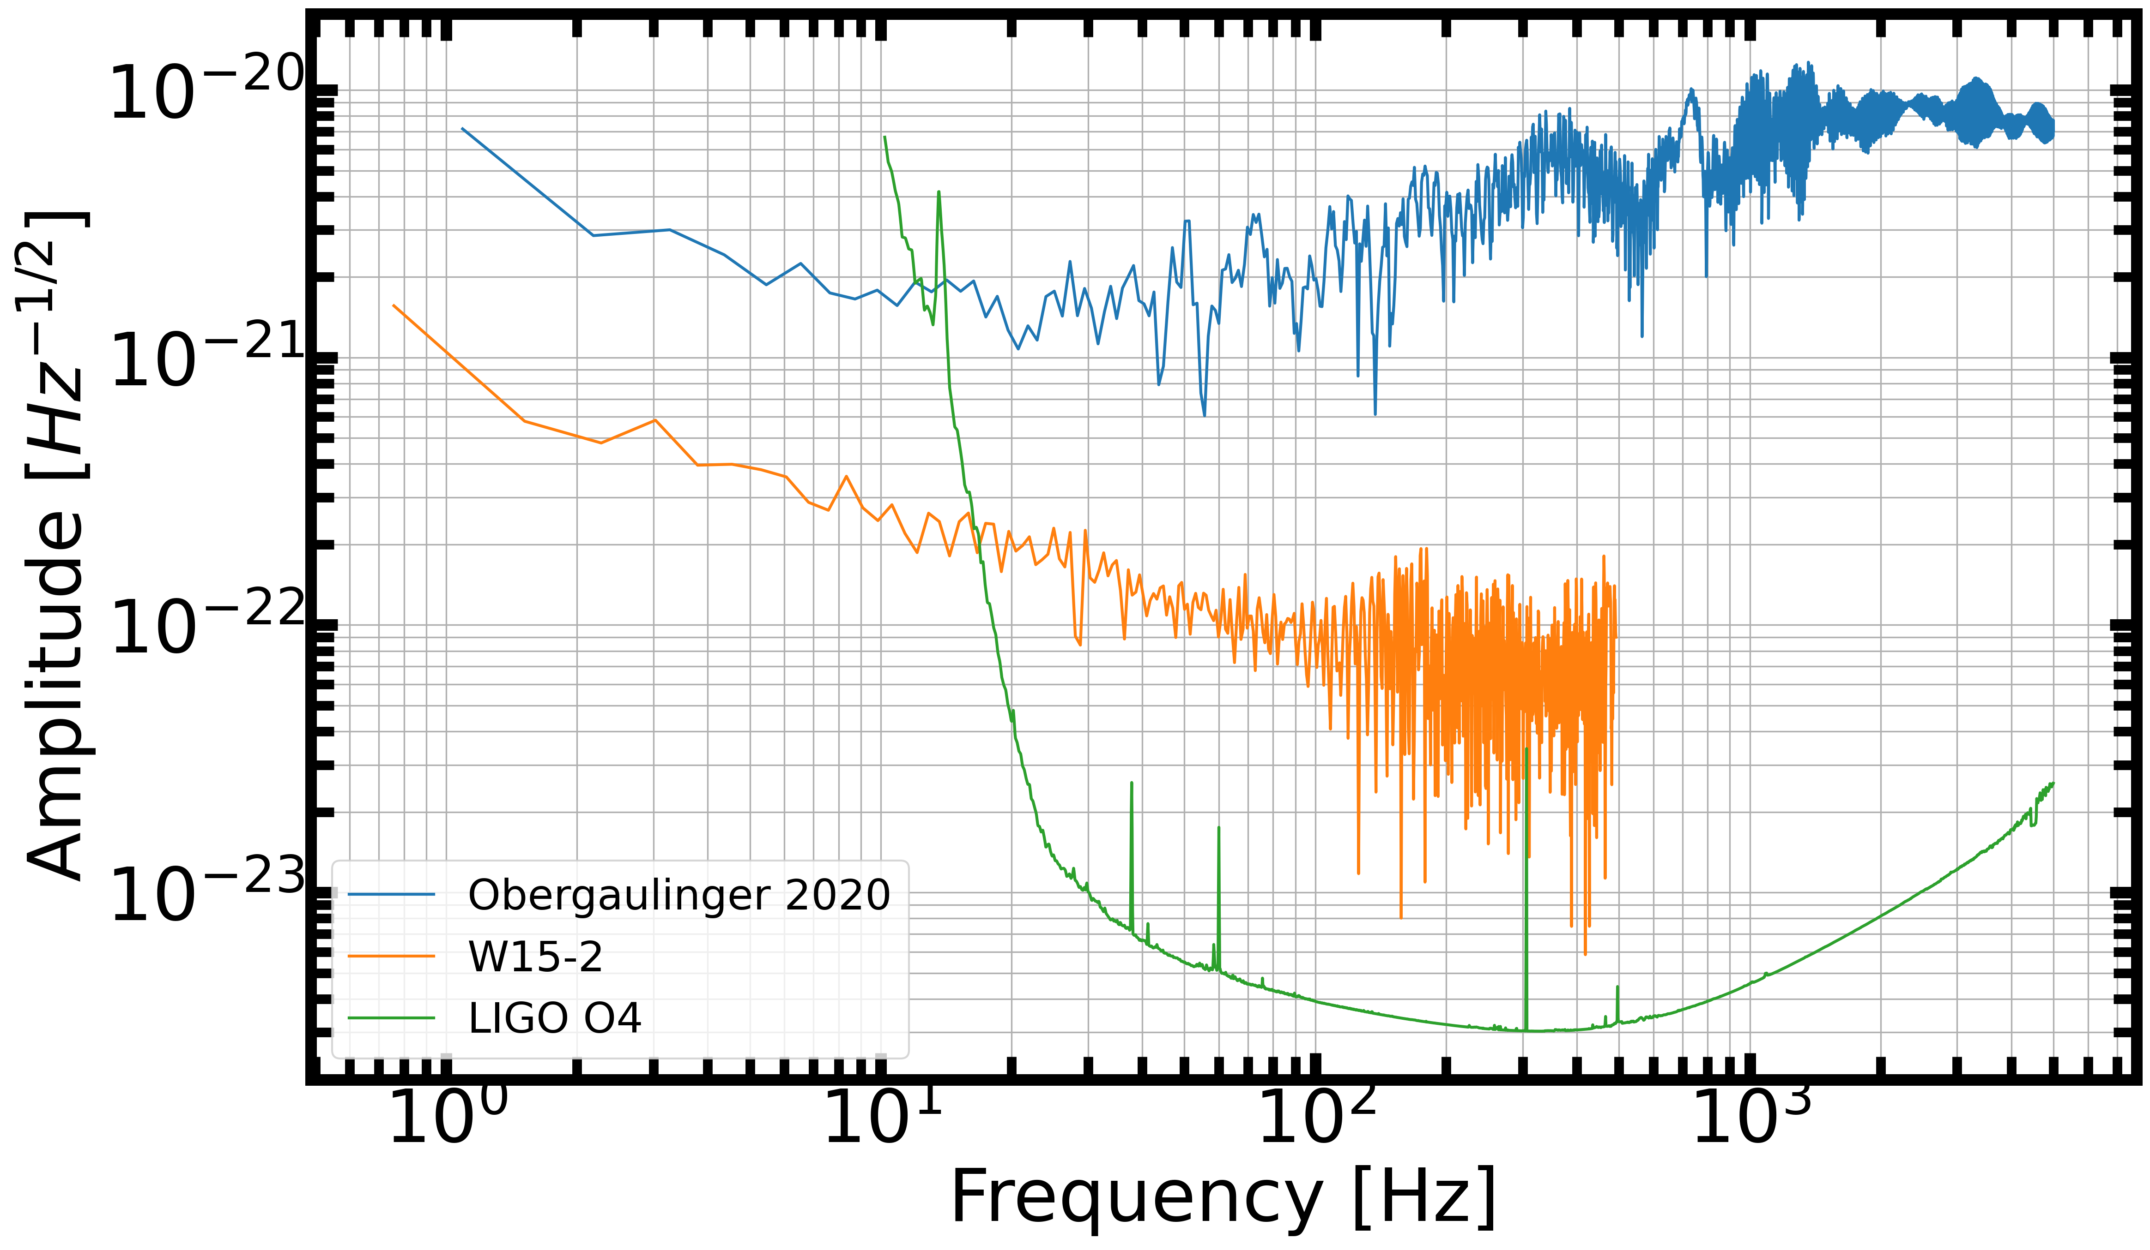
A Rotating Model [6]

Slide 25
Conclusion
We recommend tuning detection algorithms for linear GWs, and the extension and tapering of current GW signals that contain memory.
The content of this talk is in a paper to be submitted to P and P soon.
If you would like to collaborate on the future analysis projects, please contact us.
We plan to use cWB to test detectability, so we will be investigating many different waveform families that have a memory component, like Obergaulinger 2020.

Slide 26
References
Couch. 2018.
A. G. Wiseman and C. M. Will, Christodoulou’s nonlinear gravitational-wave memory: Evaluation in the quadrupole approximation, Phys. Rev. D44, R2945 (1991).
A. Torres-Forn ́e, P. Cerd ́a-Dur ́an, M. Obergaulinger, B. M ̈uller, and J. A. Font, Universal Relations for Gravitational-Wave Asteroseismology of Protoneutron Stars, Phys. Rev. Lett.123, 051102 (2019), arXiv:1902.10048 [gr-qc].
A. Wongwathanarat, E. M ̈uller, and H. T. Janka, Three-dimensional simulations of core-collapse supernovae: from shock revival to shock breakout, A&A577, A48 (2015), arXiv:1409.5431 [astro-ph.HE].
E. M ̈uller, H.-T. Janka, and A. Wongwathanarat, Parametrized 3D models of neutrino-driven supernova explosions. Neutrino emission asymmetries and gravitational-wave signals, A&A537, A63 (2012).
M. Obergaulinger and M. Aloy, Magnetorotational core collapse of possible GRB progenitors – I. Explosion mechanisms, Monthly Notices of the Royal Astronomical Society 492, 4613 (2020).

